Slide 1
Statistics
Summarising Data

Slide 2
Terms used
To describe data (or to summarise a set of scores), the following words are used:
Mean
Median
Mode
Range
Standard Deviation
Outliers

Slide 3
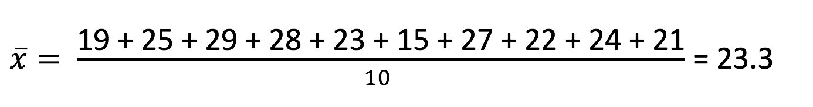
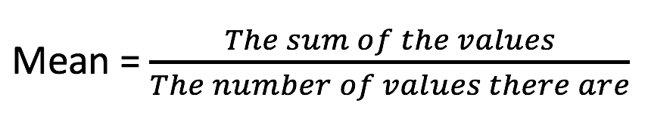
MEAN
Arithmetic average of the data (or scores)
Measure of its centre
Given a set of numbers:
19, 25, 29, 28, 23, 15, 27, 22, 24, 21

Slide 4
Mean = 16.4 = 17 passengers
Median = 16.5 = 17 passengers
Mode = 17 passengers

Slide 5
5 10 15 20 25 30
Mean = 17 passengers
Median group (median class) = 15 ≤ x < 20 passengers
Modal group (modal class) = 15 ≤ x < 20 passengers

Slide 6
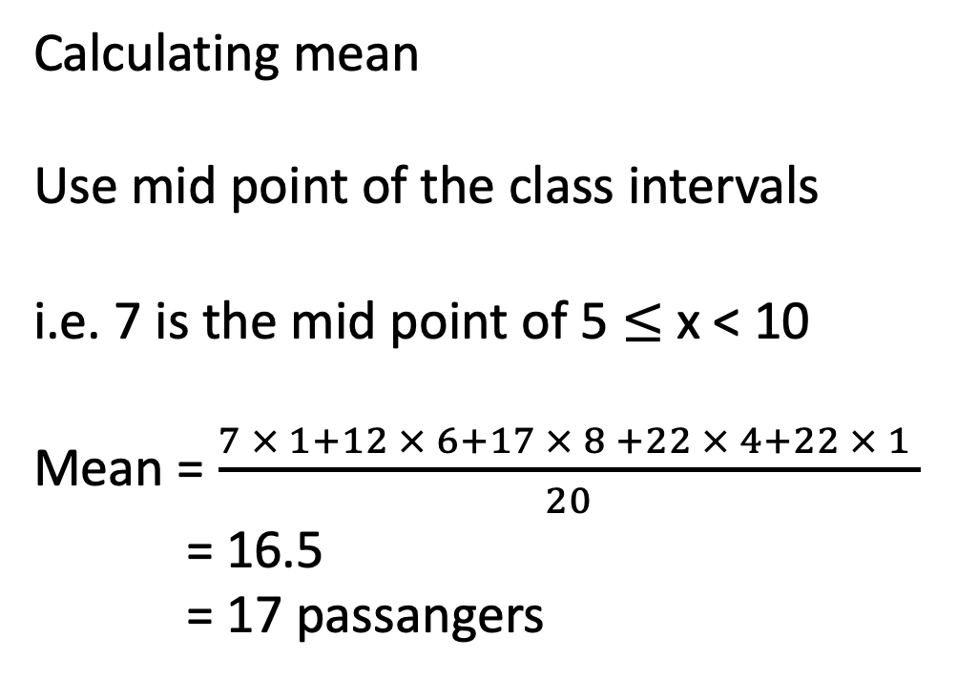
Calculating mean
Use mid point of the class intervals
i.e. 7 is the mid point of 5 $≤$ x < 10
Mean = $\frac{7 × 1+12 × 6+17 × 8 +22 × 4+22 × 1 }{20}$
= 16.5
= 17 passangers

Slide 7
MEDIAN
The middle value in an ordered set of values.
Example:
23, 24, 23, 25, 23, 26, 27, 28, 28, 23, 28, 22, 26, 28, 25
Reorder:
22, 23, 23, 23, 23, 24, 25, 25, 26, 26, 27, 28, 28, 28, 28
MEDIAN = 25
Odd number of values, the median is the middle value.

Slide 8
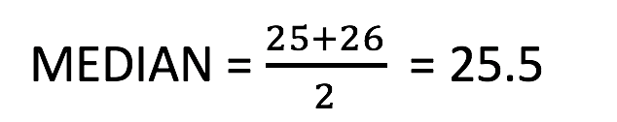
MEDIAN
Example:
23, 24, 23, 25, 23, 26, 27, 28, 28, 23, 28, 22, 26, 28, 25,26
Reorder:
22, 23, 23, 23, 23, 24, 25, 25, 26, 26, 26, 27, 28, 28, 28, 28
Even number of values, the median is the average of the two middle value.

Slide 9
MODE
Mode is the value(s) that appears the most in the set of data.
Example:
23, 24, 22, 25, 23, 26, 27, 28, 28, 23, 28, 22, 26, 28, 98
Rearrange:
22, 22, 23, 23, 23, 24, 25, 26, 26, 27, 28, 28, 28, 28, 98
Mode = 28

Slide 10
MODE
Example:
23, 24, 23, 25, 23, 26, 27, 28, 28, 23, 28, 22, 26, 28, 98
Rearrange:
22, 23, 23, 23, 23, 24, 25, 26, 26, 27, 28, 28, 28, 28, 98
Bimodal, modes = 23 and 28

Slide 11
RANGE
Range is the difference between the highest and lowest score.
Example:
23, 24, 23, 25, 23, 26, 27, 28, 28, 23, 28, 22, 26, 28, 25,26
Highest = 28 lowest = 22
RANGE = 28 – 22 = 6

Slide 12
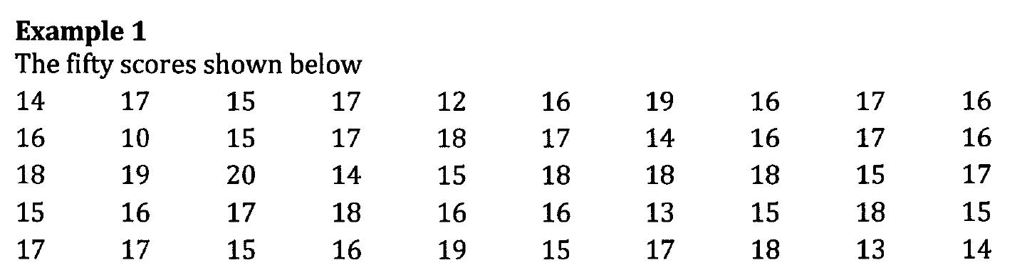
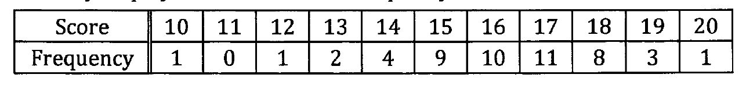
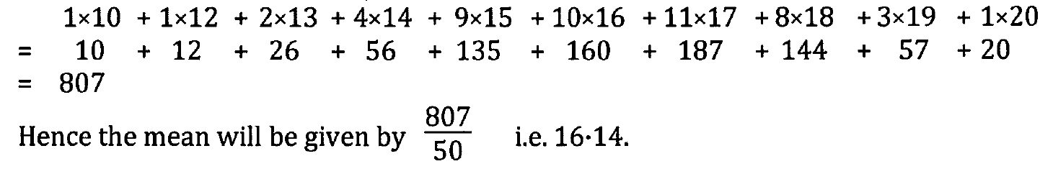
Determine the mean, mode and median.

Slide 13
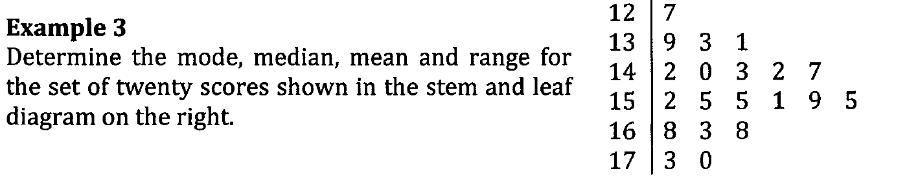
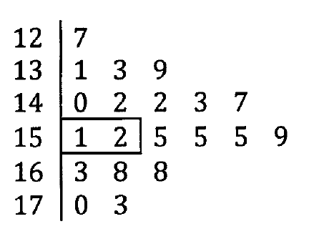

Slide 14
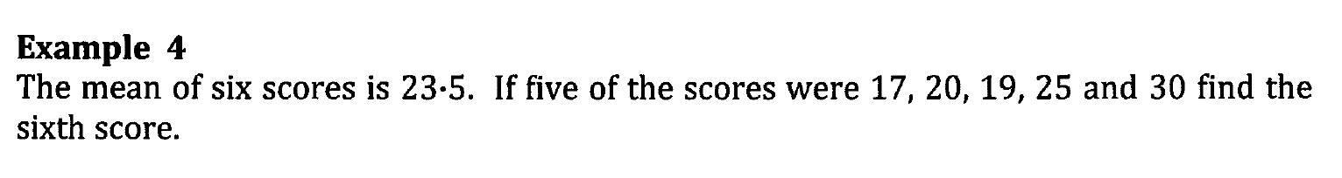
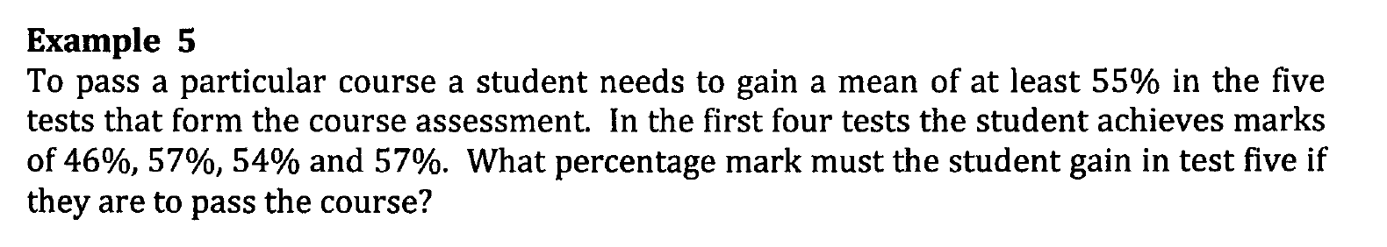
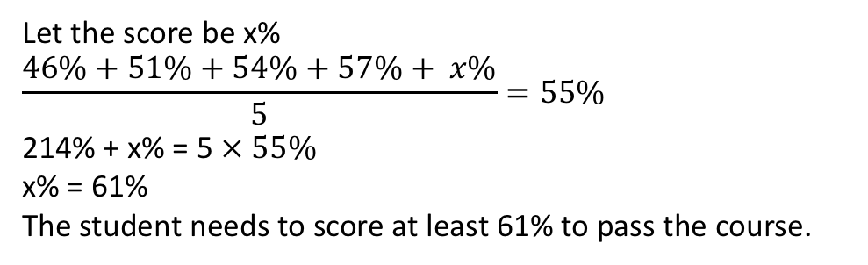
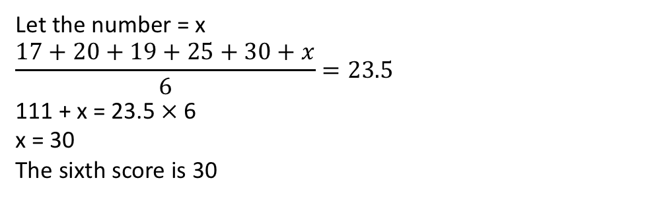
Let the number = x
$$\frac{17+20+19+25+30+x}{6}=23.5$$
111 + x = 23.5 $×$6
x = 30
The sixth score is 30
Let the score be x%
$$\frac{46\%+51\%+54\%+57\%+ x\%}{5}=55\%$$
214% + x% = 5 $× 55\%$
x% = 61%
The student needs to score at least 61% to pass the course.

